Slide 1

Vel Tech Rangarajan Dr. Sagunthala R&D Institute of Science and Technology
School of Computing
Department of Computer Science and Engineering
10211CS224 / FULL STACK APPLICATION DEVELOPMENT (JAVA)
PROJECT REVIEW : MILESTONE PROJECT – 1
Date: 23-03-2026
Real – Time Event Synchronization Engine
SDG: SDG 9 – Industry , Innovation and Infrastructure
Presented By:
B . Anjikesava – VTU25502 – 23UECS0689
Courses Handling Faculty:
Dr. S. Hemamalini – M.E., Ph.D.

Slide 2
INTRODUCTION
Background of the problem:
In many web applications, events such as meetings, webinars, bookings, and deadlines are not synchronized in real-time. Users often see outdated information due to manual refresh or delayed database updates.
Why this project is important:
Real-time synchronization ensures that users always see the latest event updates instantly without refreshing the page.
Real-world relevance:
Online booking systems, Event management platforms, Live dashboards, E-learning schedules.
Brief overview of the system:
The Real-Time Event Synchronization Engine is a web-based system that updates event data instantly across all connected users using real-time communication technology.
1
2
3
4
5
6
7
8
9

Slide 3
PROBLEM STATEMENT
In many organizations and web platforms, event updates are not reflected instantly to all users. When an admin modifies, deletes, or adds an event, other users may not see the change immediately unless they refresh the page. This causes confusion, double bookings, scheduling conflicts, and poor user experience.
There is a need for a secure and efficient real-time event synchronization system that updates event information instantly across multiple users and devices. The system must ensure data consistency, reduce delays, and improve system reliability.
1
2
3
4
5
6
7
8
9

Slide 4
OBJECTIVES
1 . To design and develop a web-based Real-Time Event Synchronization Engine.
2 . To implement instant event updates without manual page refresh.
3 . To ensure data consistency across multiple users.
4 . To provide secure admin control for event management.
5 . To improve performance and reduce synchronization delay.
1
2
3
4
5
6
7
8
9

Slide 5
PROPOSED SYSTEM
1 . The proposed system is a web-based Real-Time Event Synchronization Engine.
2 . Admin can create, update, and delete events.
3 . Users can view events in real-time.
4 . When admin modifies an event, all connected users receive updates instantly.
5 . The system uses real-time communication (WebSocket technology).
6 . It prevents double bookings and outdated data.
7 . It reduces manual refresh dependency.
8 . It improves user experience and system efficiency.
1
2
3
4
5
6
7
8
9

Slide 6
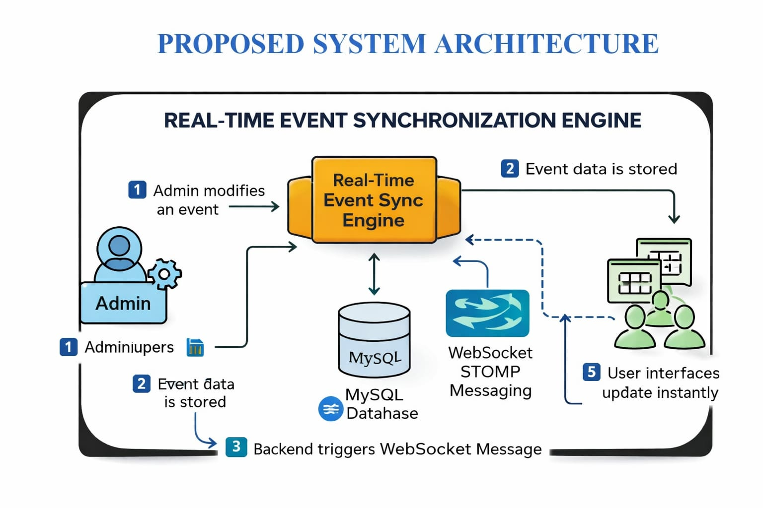
PROPOSED SYSTEM ARCHITECTURE
1
2
3
4
5
6
7
8
9

Slide 7
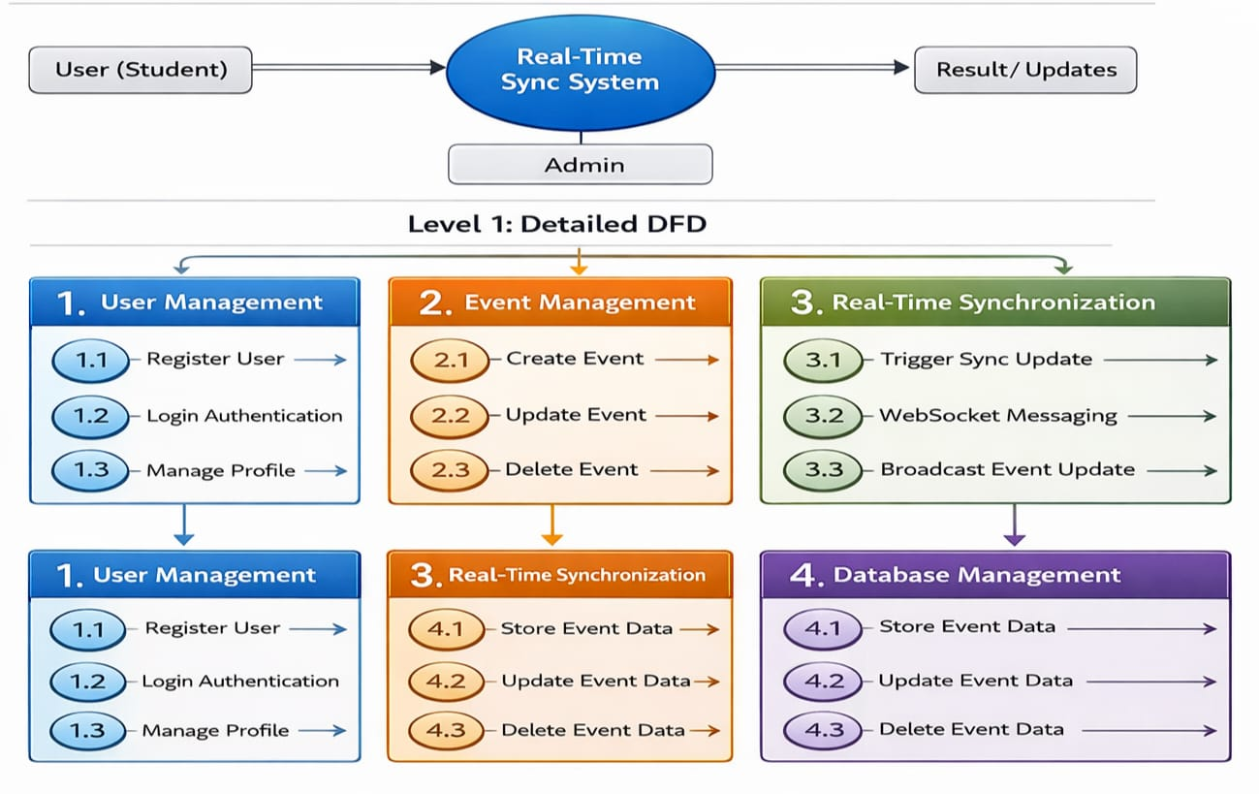
WORKFLOW
1
2
3
4
5
6
7
8
9

Slide 8
TECHNOLOGIES USED
Frontend:
1 . HTML5
2 . CSS3
3 . JavaScript
Backend:
1 . PHP
2 . MySQL
3 . Apache
Tools:
1 . XAMPP Server
2 . Visual Studio Code
Software Requirements:
1 . Windows
2 . Web Browser
1
2
3
4
5
6
7
8
9

Slide 9
MODULE DESCRIPTION
Module 1: User Management
Handles user registration, login, and authentication.
Module 2: Core Event Management
Allows Admin to create, update, and delete events.
Module 3: Real-Time Synchronization Module
Uses WebSocket to send event updates instantly to all users.
Module 4: Database Management
Stores event details and user information securely.
1
2
3
4
5
6
7
8
9

Slide 10
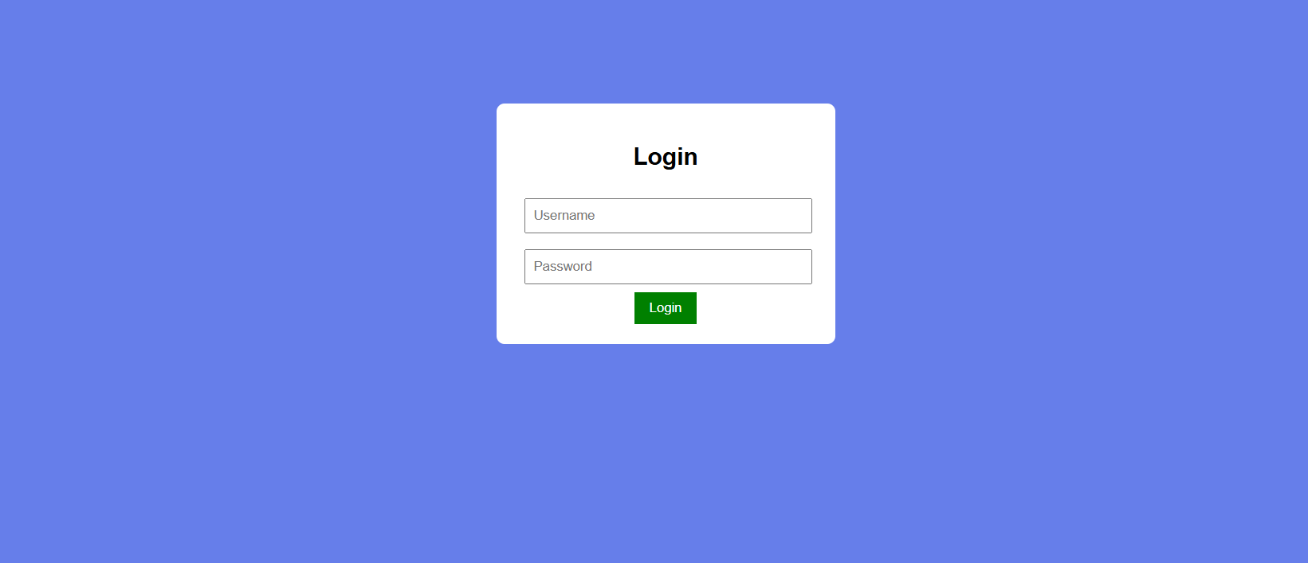
IMPLEMENTATION SCREENSHOTS
Login Page / Home Page:
1
2
3
4
5
6
7
8
9

Slide 11
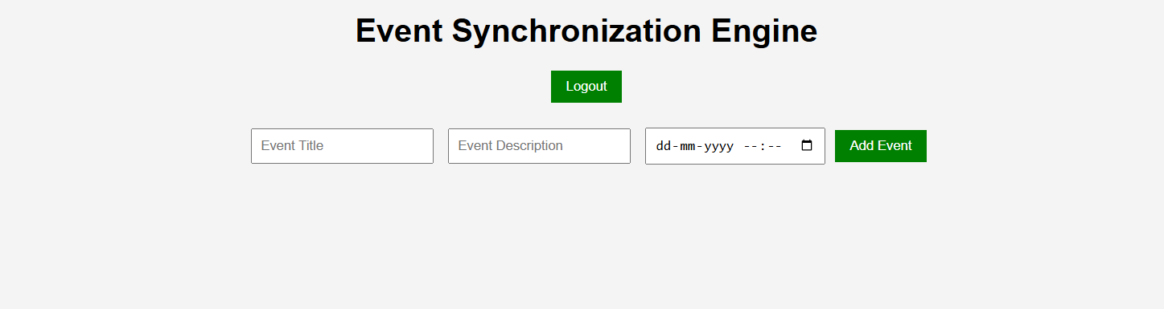
IMPLEMENTATION SCREENSHOTS
1
2
3
4
5
6
7
8(A)
9

Slide 12
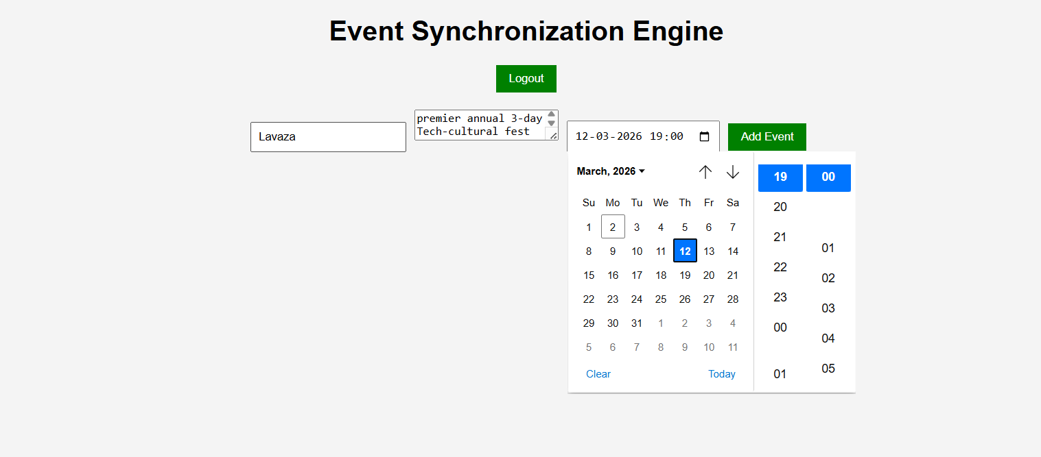
IMPLEMENTATION SCREENSHOTS
1
2
3
4
5
6
7
8(B)
9

Slide 13
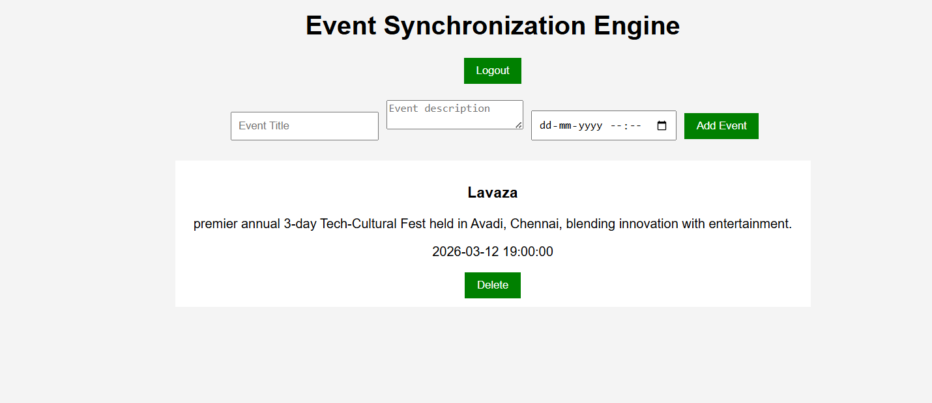
IMPLEMENTATION SCREENSHOTS
1
2
3
4
5
6
7
8(C)
9

Slide 14
ADVANTAGES & LIMITATIONS
1
Advantages:
1 . Instant Event Updates.
2 . No Manual Page Refresh.
3 . Prevents Scheduling Conflicts.
4 . Improved User Experience.
5 . Scalable System.
Limitations:
1 . Requires Stable Internet Connection.
2 . WebSocket Configuration Complexity.
3 . Security Challenges in Real-Time Systems.
4 . Server Load Handling Required.
2
3
4
5
6
7
8
9

Slide 15
Thank you

